Slide 1


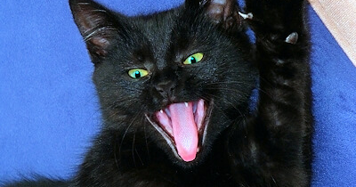
Aggression

Slide 2
Different Types of Aggression
Physical
Social
Hostile
Instrumental

Slide 3
What Motivates us to Be Aggressive?
Aggression as Instinct
Frustration-Aggression Hypothesis
Aversive Emotional Arousal
Social Learning and Aggression

Slide 4

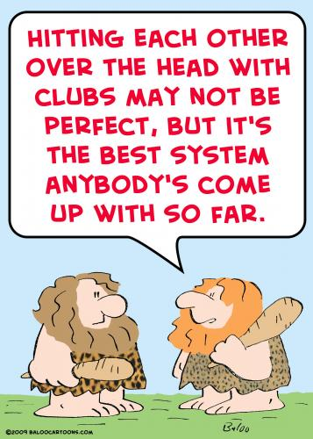
Aggression as Instinctual
It is Inherent
Essential to our Species’ Survival

Slide 5

Frustration-Aggression Hypothesis
Frustrating circumstances lead to aggression
This theory posits that (1) every frustration leads to an aggressive act and (2) every aggressive act is a result of some past frustration

Slide 6

Aversive Emotional Arousal
Aversive Emotion as the Cause of Aggression
Negative emotion such as anger, discomfort
Aggression reduces or eliminates the negative emotion

Slide 7
Social Learning and Aggression
Learned Through Imitation or Reinforcement
Classic Case: Bandura and the Bobo Doll Experiment

Slide 8

Targets of Aggression
Gender
Race
Whether there was Intent
Whether there might be Retaliation

Slide 9
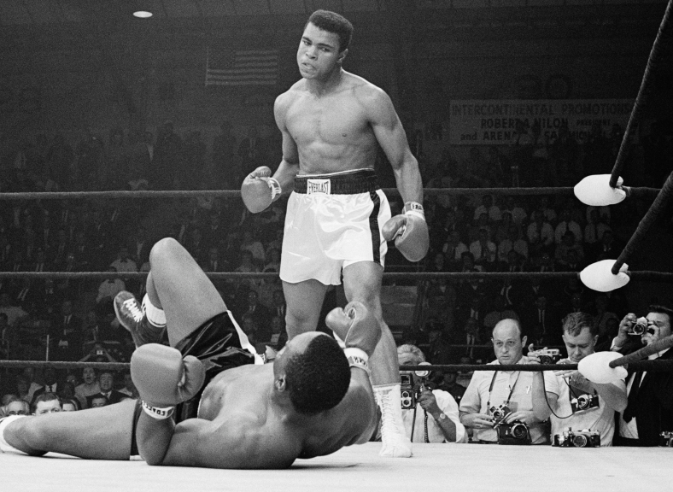
Situational Factors
Potential Rewards
Modeling
Norms
Stress
Aggressive Cues

Slide 10




Aggression in Society – Sexual Assault

Slide 11
Reducing Aggressive Behaviour
Reducing Frustration
Catharsis
Punishment

Slide 12


Have a Great Day!

